Slide 1


NON-TEXTUAL DATA EXTRACTION
José Antonio Ruiz Heredia
Joseph Tartivel
Álvaro Honrubia

Slide 2
MOTIVATION
01
STATE OF THE ART
02
DATASET
TABLE OF CONTENTS
03
IMPLEMENTATION
04
OTHER EXPERIMENTS
05
IMPROVEMENTS
A brief introduction of the project.
Presentation of research paper used for this work.
Presentation of the dataset used
Description of the implementation of the project.
Quick summary of multiple experiments we did during this project.
06
A view of potentials improvements.

Slide 3
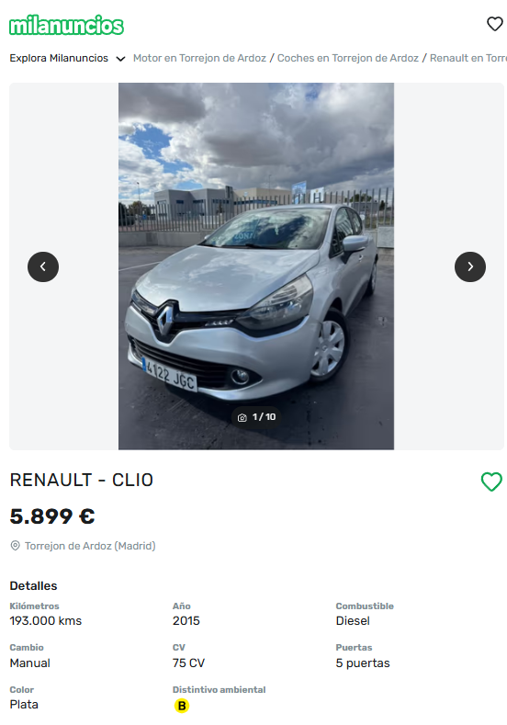
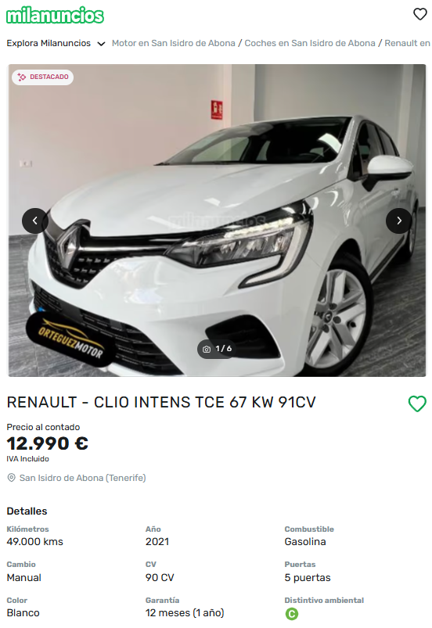
MOTIVATION
Problem: Incomplete and inaccurate car listings on Milanuncios.
Solution: Use CBIR to suggest accurate car details from images.
Method: ORB for shape matching + CCH & SCH for color refinement.
Challenges: Image variations, similar models, and color inconsistencies.
Impact: More accurate listings, better search results, improved user experience.

Slide 4
STATE OF THE ART
ORB: Fast and Robust Feature Detector
COLOR: CCH & SCH
Open-source alternative to SIFT & SURF
Key Components:
FAST (with intensity centroid)
rBRIEF (with learning-based feature selection)
Applications:
Feature extraction for tracking & recognition
Enhanced object detection
Efficient large-scale image search
Hybrid image retrieval
Double Color Histogram for CBIR
Conventional Colour Histogram (CCH) for global color distribution
Stacked Colour Histogram (SCH) to capture texture information
Why It Matters for Car Image Matching
Robust against lighting, angle, and transformation variations
Distinguishes cars with similar shapes but different textures/colors
Improves accuracy in identifying visually similar vehicles

Slide 5
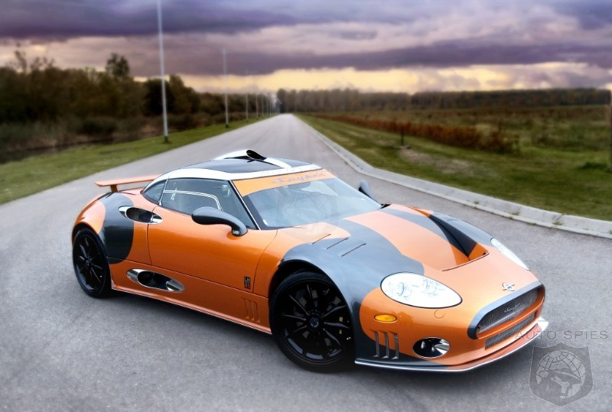
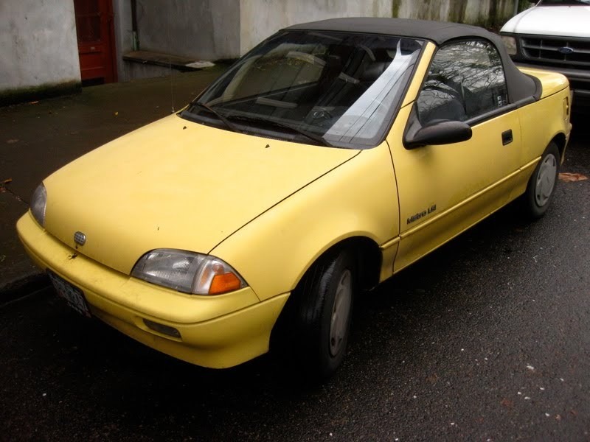
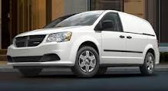
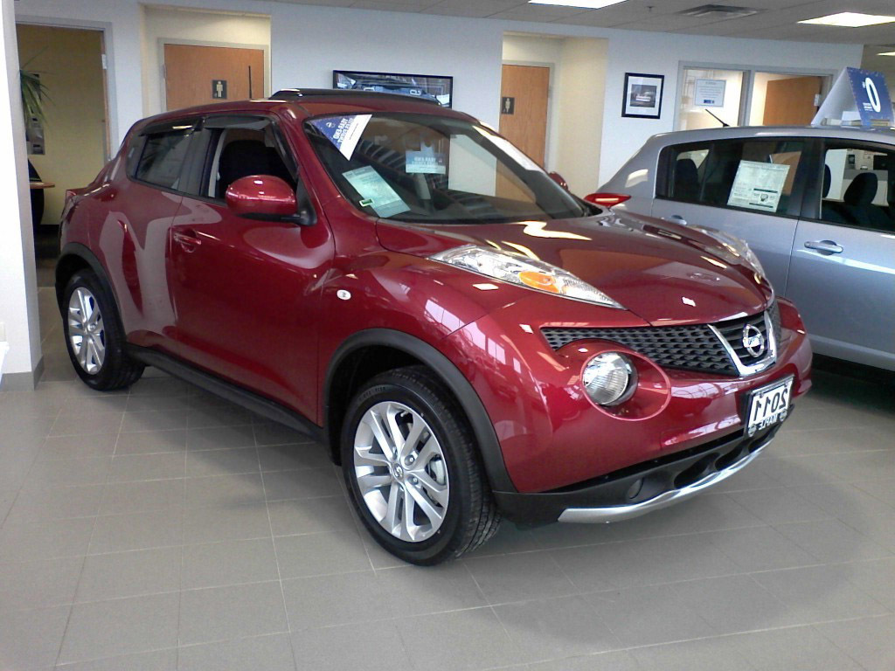
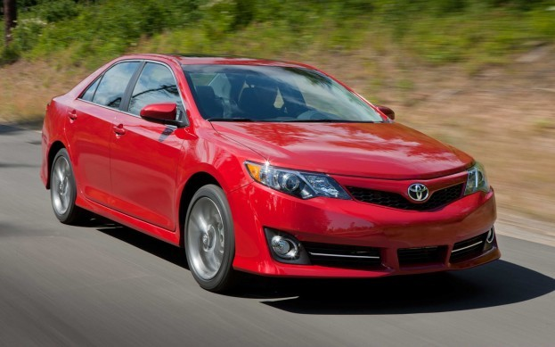
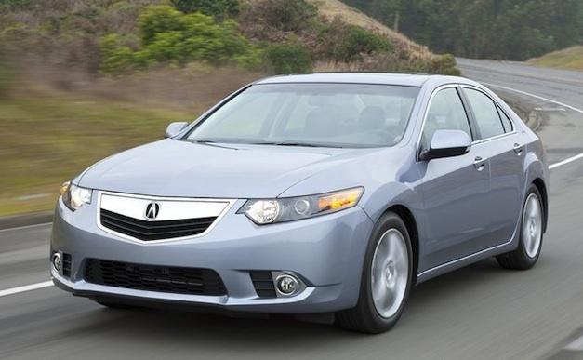
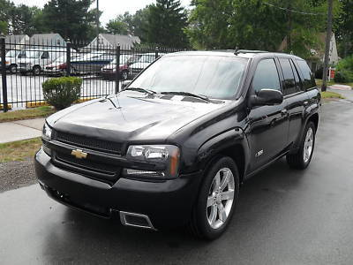
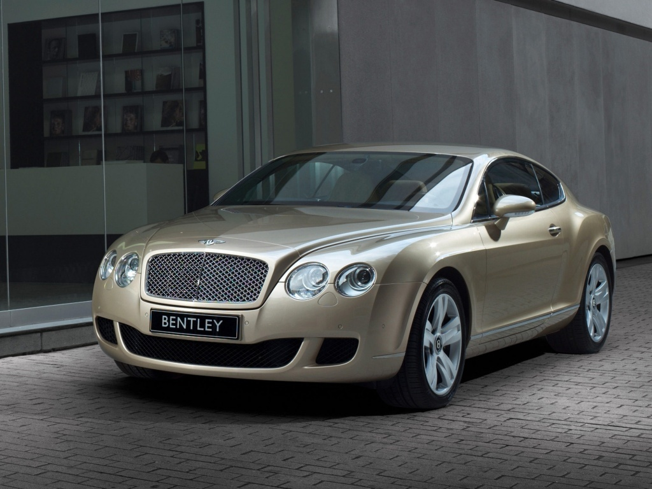
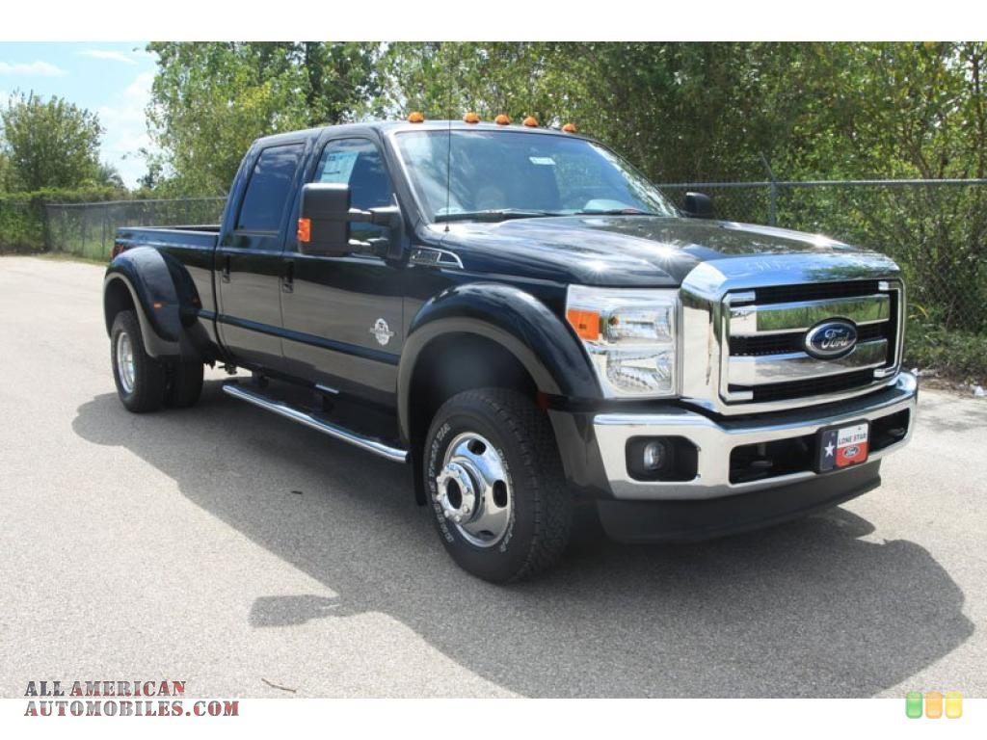
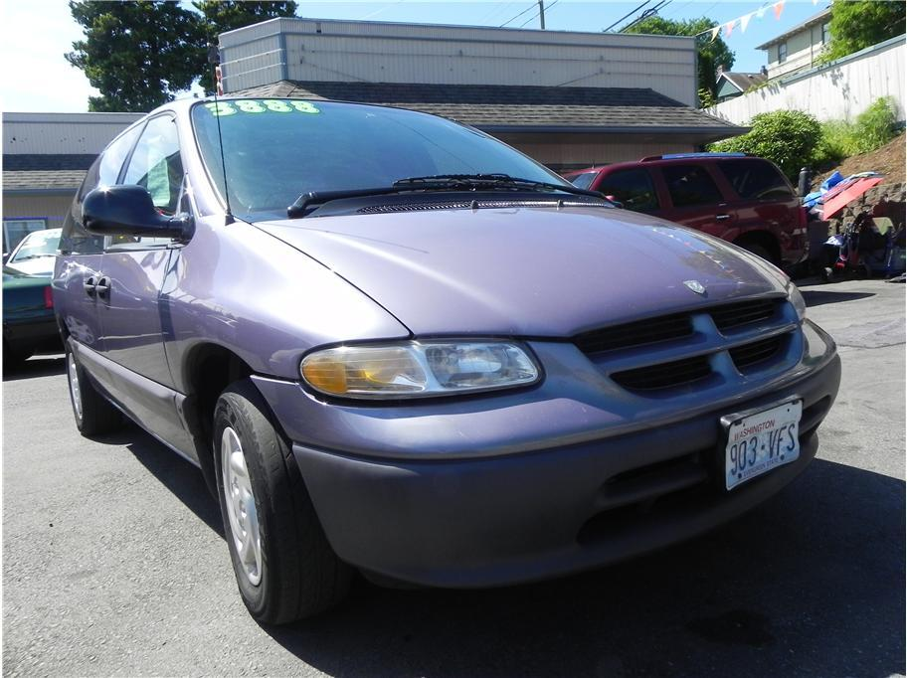
DATASET
Stanford Cars Dataset with 16,185 images
Diverse range of vehicle models
Dataset’s detailed metadata offer additional classification insights for future improvements

Slide 6
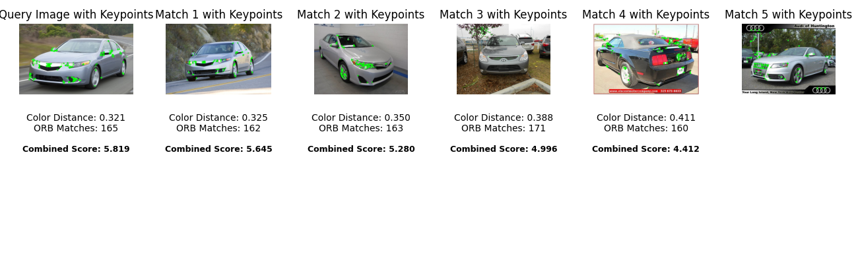
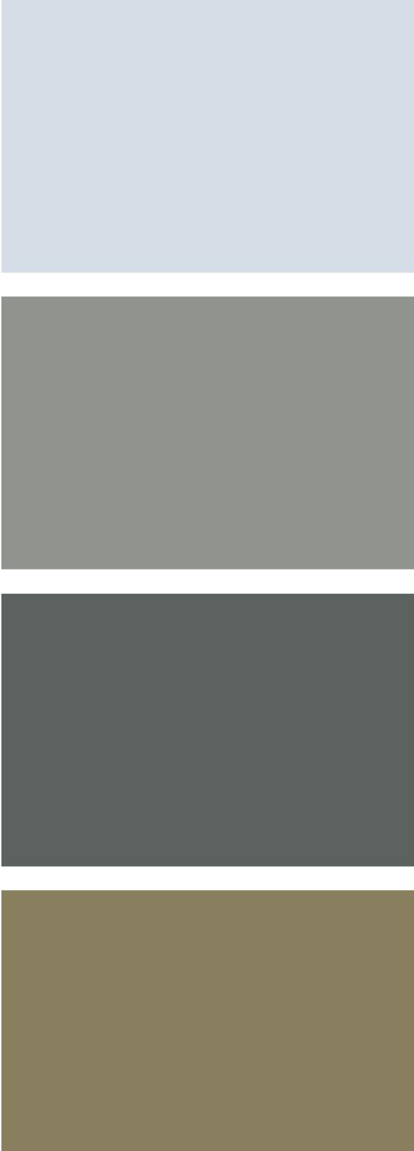
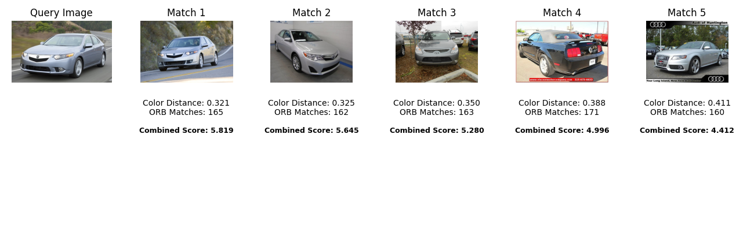
IMPLEMENTATION
ORB MATCHER
COLOR MATCHER
HYBRID MATCHING
Uses ORB (Oriented FAST and Rotated BRIEF)
Compares the query image's descriptors against the descriptors of the dataset
Matches based on the number of keypoint using a brute-force matcher
Computes two types of color-based features:
CCH based on standard RGB color histograms.
SCH applies blur and averaging over several iterations
Both combined into a single vector to find similar images.
integrates the ORB and color-based results to provide a combined ranking
Filters top n images using ORB matcher.
Compute color features of the filtered list.
Calculate a combined score
Display top results with metrics and scores.

Slide 7
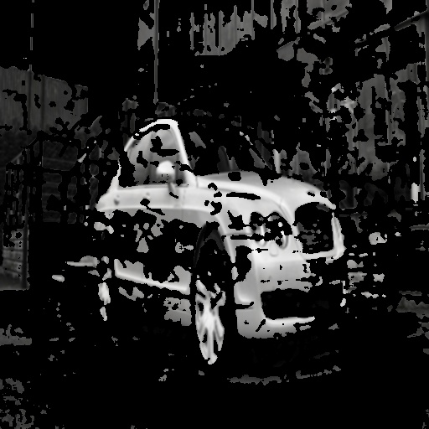
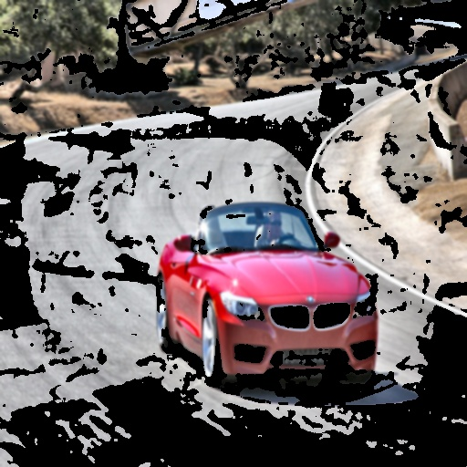
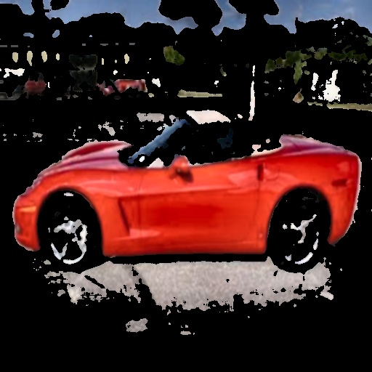
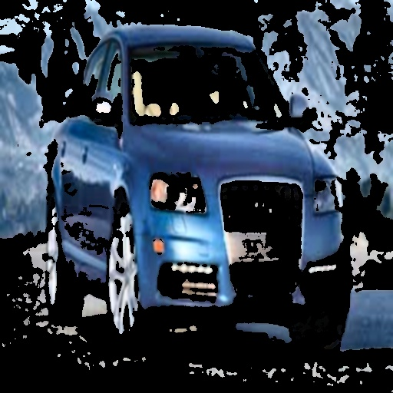
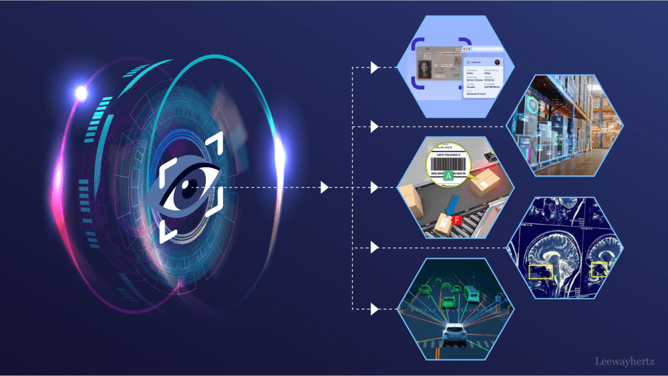
OTHER EXPERIMENTS
BACKGROUND REMOVAL
ORB MATCHER ALTERNATIVES
Remove the background from images while preserving the foreground
Image Standardization:
Background Removal (BackgroundSubtractorMOG2)
Dataset Processing
Finally, result didn’t match the required expectations
Experimented with other two feature matching techniques:
FLANN uses Locality Sensitive Hashing (LSH) for fast nearest neighbor searches.
HNSW is a graph-based algorithm from Faiss that provides efficient similarity search for high-dimensional data.
Both methods didn't enhance the outputs by BF Matcher

Slide 8
Background removal
Standardize images
Experiment ORB matcher alternatives
Methods beyond color matcher
IMPROVEMENTS
Implement robust segmentation techniques to isolate subject from surroundings
Evaluate performance of different algorithms across varied conditions
Develop normalization procedures for lighting variations
Create position calibration for consistent vehicle orientation
Implement bias correction methods for environmental factors
Evaluate SIFT, SURF, AKAZE and other feature detection algorithms
Compare performance metrics: accuracy, processing time, robustness
Investigate texture-based recognition approaches
Explore deep learning-based feature extraction
Research hybrid methods combining multiple recognition strategies

